Slide 1
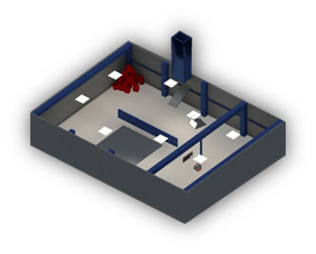
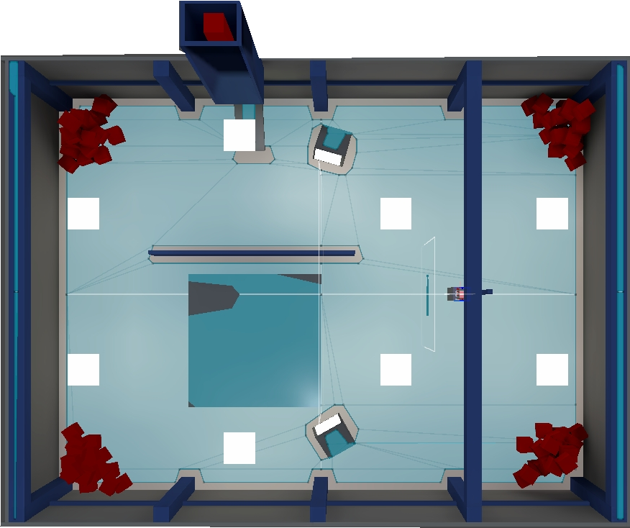
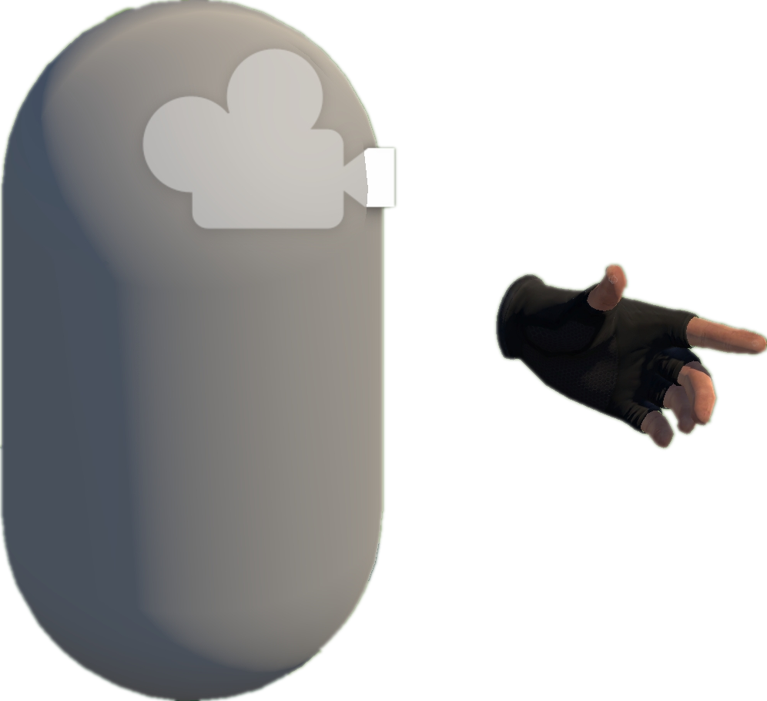









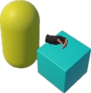
VRExplorer Test
Project Collection
Exploration and Interaction
Preliminary Scene Configuration
3
1
Camera
Open Source
Repositories
Hand Controller
Bake NavMesh
Collider
Original Scene
VRExplorer
Tags & Topics
Scene Analysis & Interaction
Scene with NavMesh
Unity-based Projects
Implementation Interface
Entity Manager
2
Plugins/Tools/.dll
Customizing Entity Interface Configuration
List<BaseEntity > e;
List<Mono > m;
Manifest Validation
& Manual Check
Input the Next Interactable Object’s Mono
Mono Scripts Implemented Entity Interface
Execute Task Asynchronously
Quality Unity-based
VR Projects
Core C# Scripts
Original Code
Task Generator
List<BaseAction> GetTask(BaseEntity [] e);
List<BaseAction> GetTask(Mono m);
Manual Analysis
Output Current Task in the form of List<BaseAction>
Pre-defined & Customized Task Model
Hierarchy Analysis
Grab-And-Drag-Box Task
Parallel and serial combinations
Move to approcach
Parallel Action
Environment
Grab
Move Action
Grab Action
Interactables
Base Action
Move Action
Box
Inherit
Walk Around
Asynchronous BaseAction
Feature
Extraction
Grab Action
Trigger Action
Grab
Base Entity
Trigger
EAT Framework
C# Scripts File
Game Logic Code & Third Plugin Analysis
Inherit
Grabbable Entity
Triggerable Entity
Task Layer
Entity Interface
Action Layer
GameObjects
Implement
Entity Layer
Unity Scene
XR Box
XR Joystick
XR Button
Mono Layer
Third Plugin / .dll / Third Assembly
Notes:
单击此处添加文本

